Slide 1
American Romanticism
1800-1855

Slide 2
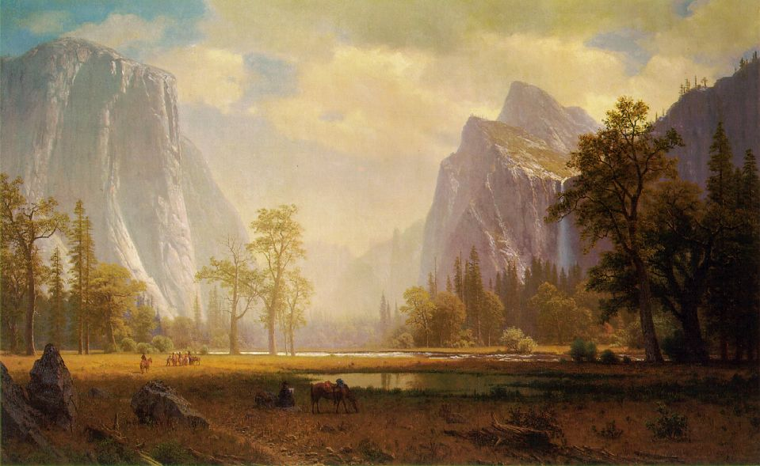
Romanticism focused on the individual and nature

Slide 3
History of Romanticism
Romantic writers had a feeling of optimism
America was in a period of growth & opportunity
Industrial Revolution began
Prompted writers to seek answers to life in nature and self

Slide 4
Characteristics of Romanticism
Celebrated individual spirit, emotion, imagination and nature
Found inspiration in nature –not in the fear of God or strict doctrines of the Puritans
Writers turned inward for a sense of truth

Slide 5
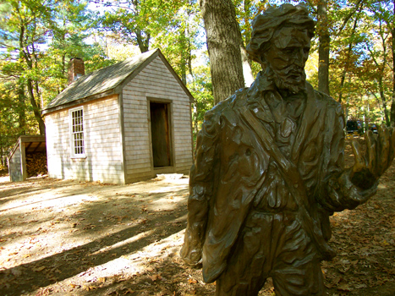
Types of Romantic Writers
Transcendentalists
Ralph Waldo Emerson
Henry David Thoreau
American Gothic
Edgar Allen Poe
Nathaniel Hawthorne

Slide 6
Transcendentalists
Philosophical and literary movement that emphasized living a simple life, celebrating truth found in nature
Believed that people are inherently good
Disliked commercial, financial side of America
Stressed spiritual well-being, intellectual activity and close relationship to nature
Believed intuition can lead to knowledge

Slide 7
Transcendentalist Writers
Henry David Thoreau - Walden Pond
Ralph Waldo Emerson – “Self – Reliance” faith in the integrity of the individual
Walt Whitman, Robert Frost – later Transcendentalists

Slide 8
American Gothic
Did not believe in the innate goodness of people
Explored the human capacity for evil
Mysterious forces that motivate human behavior, elements of supernatural
Darker view of the world
Agreed with romantic emphasis on emotion, nature, and the individual

Slide 9
American Gothic Writers
Edgar Allen Poe – The Raven, Tell-Tale Heart, The Pit & the Pendulum
Nathaniel Hawthorne – The Scarlet Letter
Modern day Gothic – Stephen King, Anne Rice

